Slide 1
Restaurant Location in San Francisco
Apr. 29th 2020
Zijie Xia

Slide 2
Background: Restaurant location in San Francisco (SF)
San Francisco:
one of the major cities in the United States
has a highly diverse population
has one of the biggest China town in the country
Opening a Chinese restaurant can attract lots of locals who have interest in the authentic Chinese food
However, due to the advantages of SF, a new restaurant also faces major competitions
A good location is important for the success of a new restaurant
Some factors to consider for a good location include population and competitions

Slide 3
Data Acquisition and Cleaning
SF neighborhood data is downloaded from
https://data.sfgov.org/Geographic-Locations-and-Boundaries/SF-Find- Neighborhoods/pty2-tcw4
SF zipcode data is scraped from http://www.healthysf.org/bdi/outcomes/zipmap.html
SF latitude and longitude data is imported from a separate csv file.
https://github.com/ZBerylX-lab/first-repository/blob/master/SF%20zip%20code%20LatLon.xlsx?raw=true
In the raw data for neighborhoods, 117 rows and 3 features in the raw dataset.
In total 21 rows and 3 features in the raw dataset for zipcode-based SF neighborhood information
Repeated row and a row for total numbers are dropped
Dataframes are combined to make a final dataframe containing 21 rows and 5 features

Slide 4
Existing Restaurants Data
The data of existing restaurans are obtained from FourSquare
All the venues returned from FourSquare are counted under the food section
The number of Chinese restaurants (including all subcategories) as well as the number of popular Asian restaurants (not including Chinese restaurants) are summarized for each neighborhood
K-mean clustering is used to group the 21 neighborhoods based on populations, the number of Chinese restaurants, and the number of Asian restaurants

Slide 5
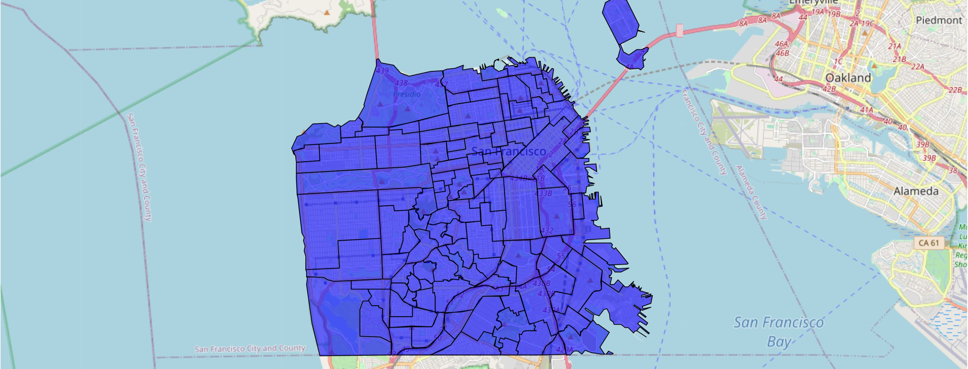
SF Neighborhoods
117 neighborhoods of SF plotted on the map based on geojson data
Too many neighborhoods for decision making
Each neighborhood size is very different from each other

Slide 6
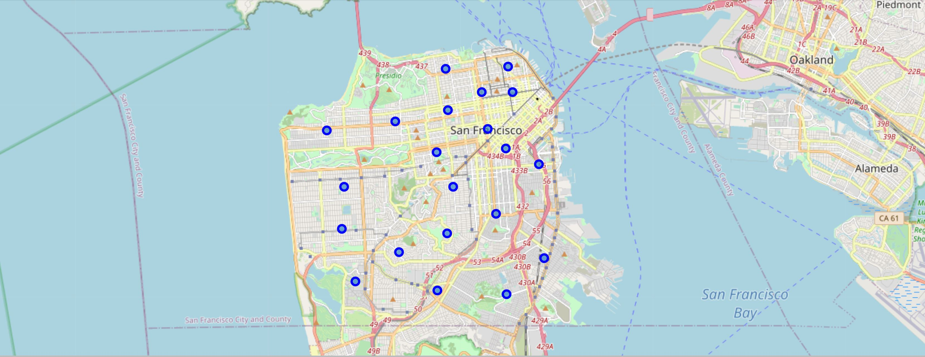
SF Zipcode-Based Neighborhoods
21 neighborhoods of SF plotted on the map based on latitude and longitude
Each zipcode covers more consistent size of area

Slide 7
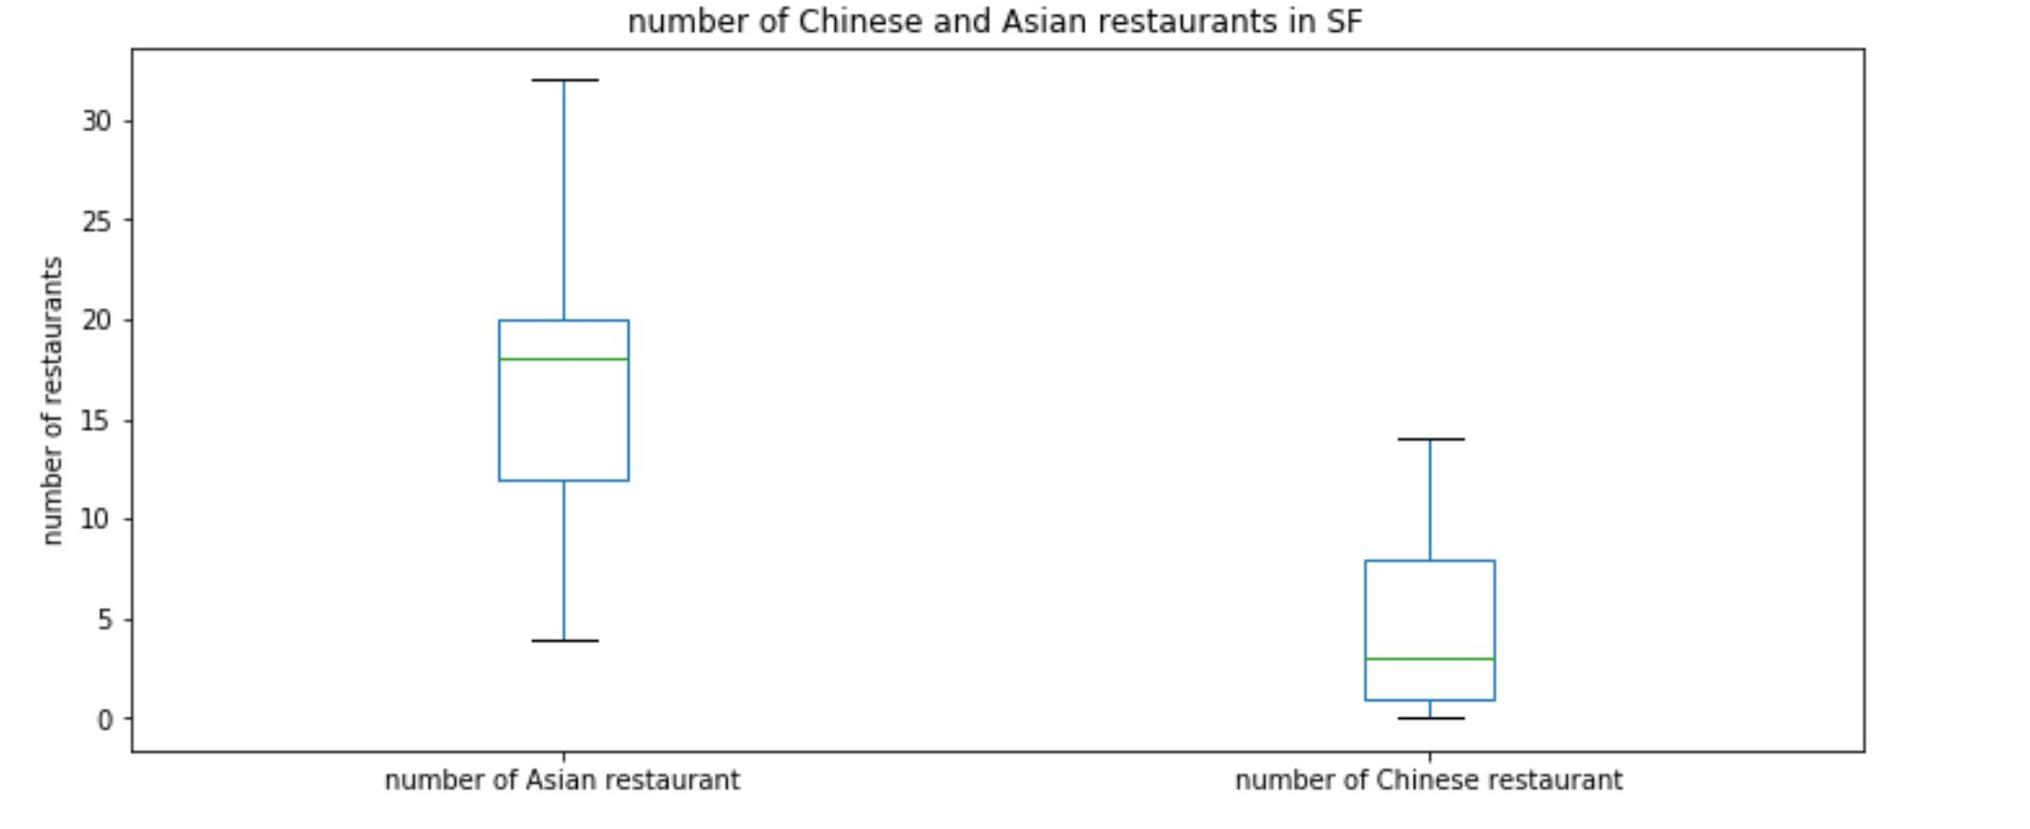
Existing Restaurant Data：Box Graph

Slide 8
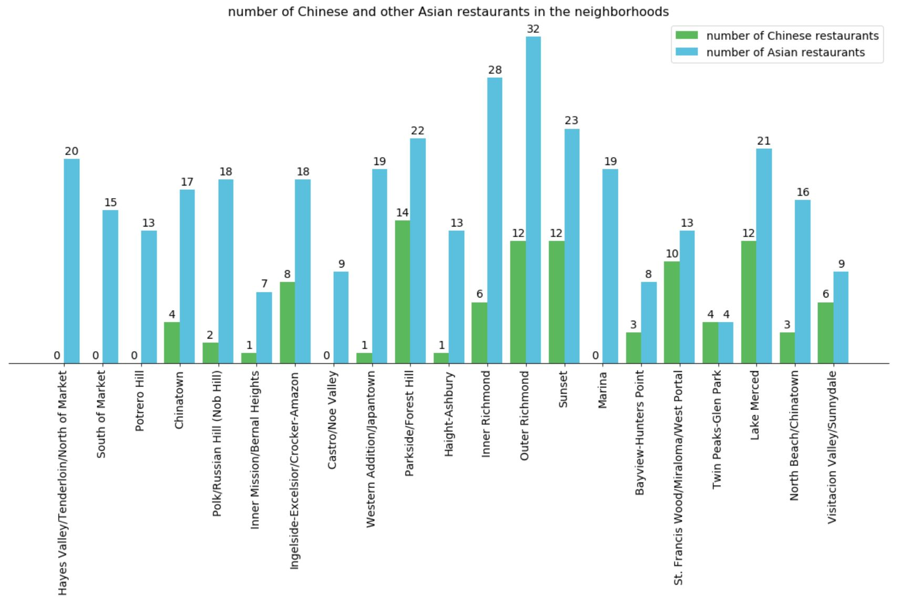
Existing Restaurant Data：Bar Graph

Slide 9
Table including K-means Clustering Labels
Zip Code | Neighborhood | Population | Latitude | Longitude | number of Chinese restaurant | number of Asian restaurant | label
94102 | Hayes Valley/Tenderloin/North of Market | 28991 | 37.77933 | -122.419 | 0 | 20 | 0
94103 | South of Market | 23016 | 37.77233 | -122.411 | 0 | 15 | 0
94107 | Potrero Hill | 17368 | 37.76653 | -122.396 | 0 | 13 | 0
94108 | Chinatown | 13716 | 37.79268 | -122.408 | 4 | 17 | 0
94109 | Polk/Russian Hill (Nob Hill) | 56322 | 37.79278 | -122.422 | 2 | 18 | 2
94110 | Inner Mission/Bernal Heights | 74633 | 37.74873 | -122.415 | 1 | 7 | 2
94112 | Ingelside-Excelsior/Crocker-Amazon | 73104 | 37.72093 | -122.442 | 8 | 18 | 2
94114 | Castro/Noe Valley | 30574 | 37.75843 | -122.435 | 0 | 9 | 0
94115 | Western Addition/Japantown | 33115 | 37.78613 | -122.437 | 1 | 19 | 0
94116 | Parkside/Forest Hill | 42958 | 37.74338 | -122.486 | 14 | 22 | 1
94117 | Haight-Ashbury | 38738 | 37.77094 | -122.443 | 1 | 13 | 0
94118 | Inner Richmond | 38939 | 37.78203 | -122.462 | 6 | 28 | 1
94121 | Outer Richmond | 42473 | 37.77873 | -122.493 | 12 | 32 | 1
94122 | Sunset | 55492 | 37.75838 | -122.485 | 12 | 23 | 1
94123 | Marina | 22903 | 37.80103 | -122.438 | 0 | 19 | 0
94124 | Bayview-Hunters Point | 33170 | 37.7328 | -122.393 | 3 | 8 | 3
94127 | St. Francis Wood/Miraloma/West Portal | 20624 | 37.73496 | -122.46 | 10 | 13 | 3
94131 | Twin Peaks-Glen Park | 27897 | 37.7418 | -122.438 | 4 | 4 | 3
94132 | Lake Merced | 26291 | 37.72423 | -122.48 | 12 | 21 | 1
94133 | North Beach/Chinatown | 26827 | 37.80188 | -122.41 | 3 | 16 | 0
94134 | Visitacion Valley/Sunnydale | 40134 | 37.71958 | -122.411 | 6 | 9 | 3

Slide 10
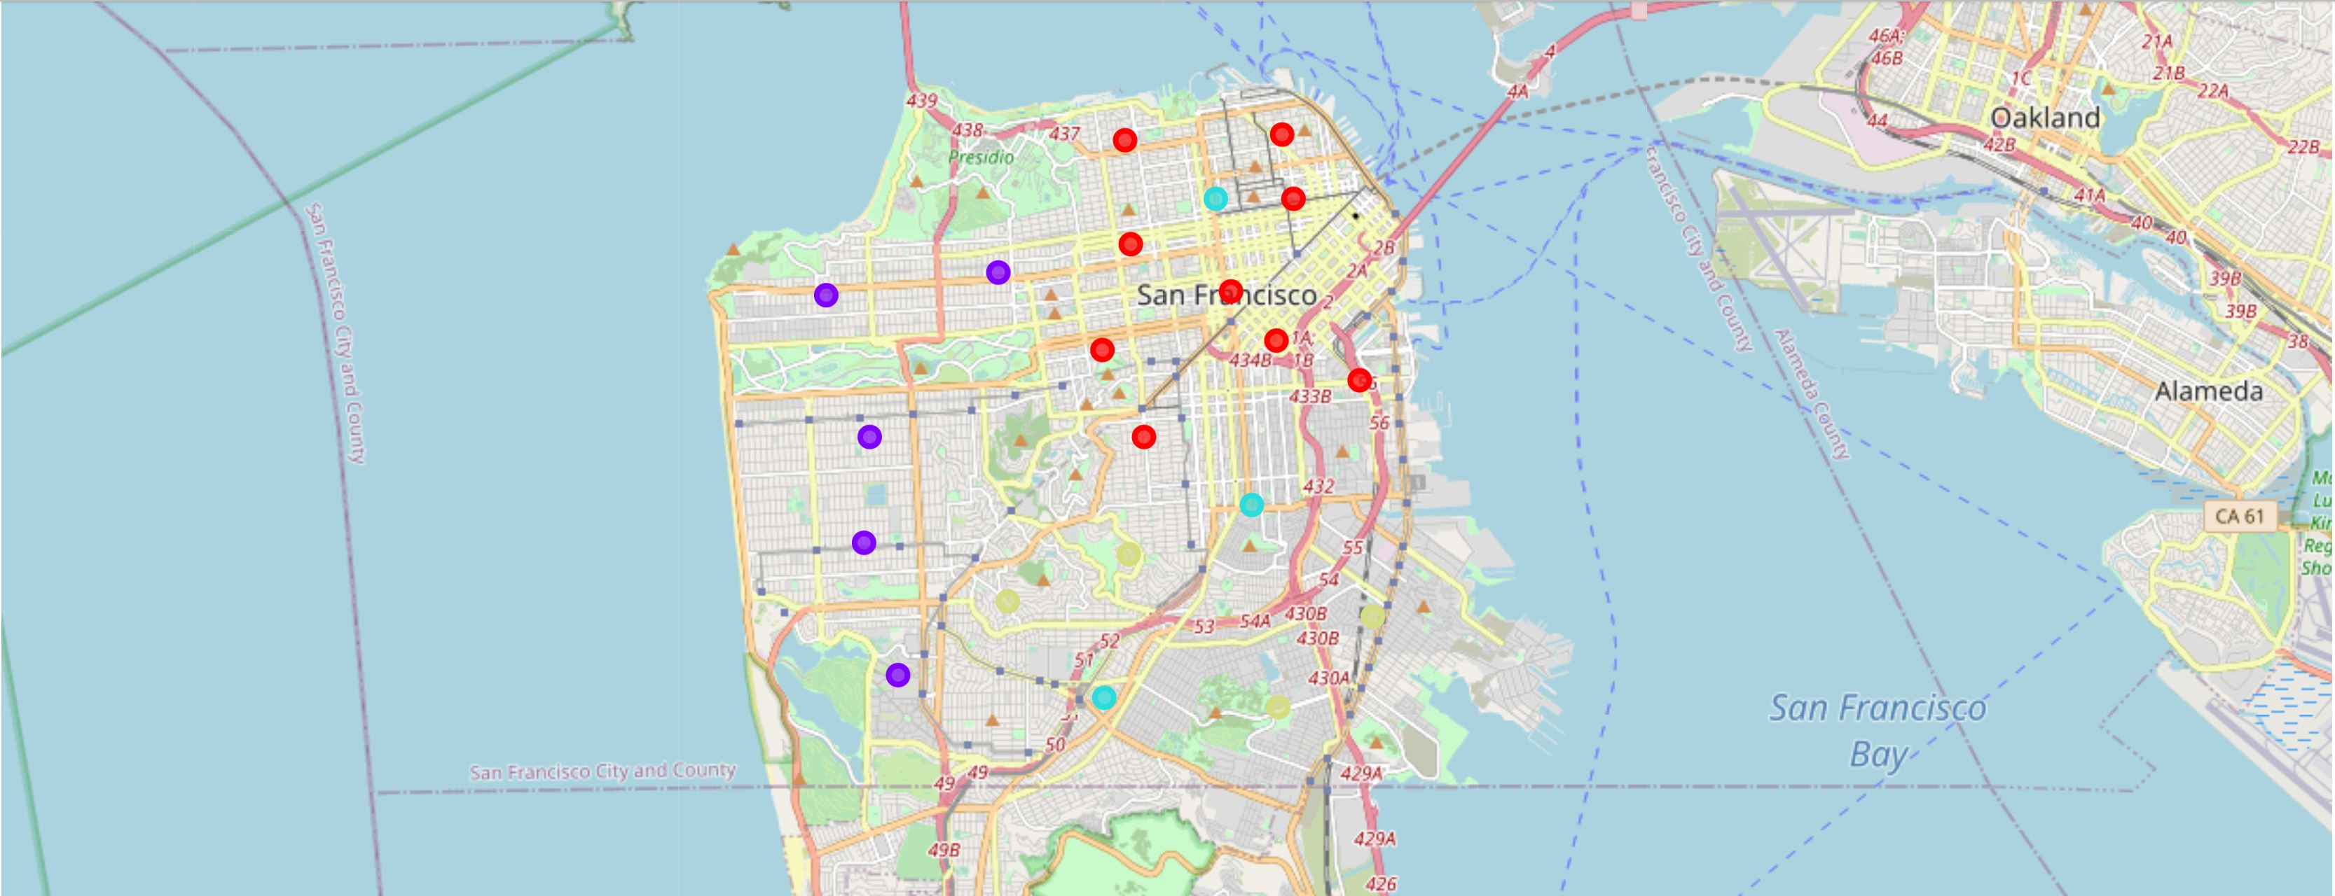
Neighborhood Clustering (K-means)
Red: little Chinese and Asian restaurants and low populations
Purple: average populations and with high numbers of Chinese and Asian restaurants
Blue: some Chinses and Asian restaurants and low populations
Yellow: neighborhood with some Chinese and Asian restaurans and high populations

Slide 11
Conclusion and Future Directions
Use K-means Clustering to analyze existing restaurants and populations in SF
The model can include more information data, such as income for the neighborhood to get a better idea which location is better for a new restaurant
FourSquare only allows return of 100 venues giving latitude and longitude
A slightly finer division of each neighborhood can help narrow down the area of interest

